Slide 1
Partnerships, Strategic Collaborations, Mergers and Acquisitions
Anne Meysenburg, MPA
Sarah Sjolie, MPA
August 2025
Notes:
TB

Slide 2


Introductions
Nathan Morgan
Donor Services Advisor
Dasia Horne
Sr. Program Manager
Notes:
Nathan and Dasia introduce themselves and being a contact for what she does.
Dasia: Welcome, everyone. Today, we’ll explore how to cultivate meaningful donor relationships beyond transactions, fostering lasting partnerships that drive our missions forward.

Slide 3
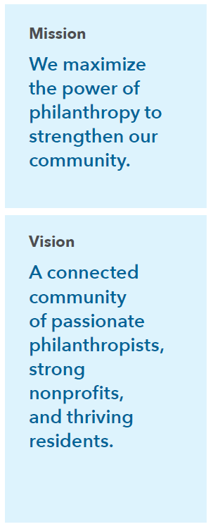
Our Mission and Vision
Notes:
Nathan
Community Foundations are 501c3 nonprofit organizations
We offer a variety of charitable giving tools, community connections, and grantmaking services
Our mission is: maximizing the power of philanthropy to strengthen our community

Slide 4

What is a Community Foundation?
900+ community foundations nationwide
Structure: 501(c)(3)
National Standards Accreditation
Giving tools
    Charitable giving funds
    Concierge level service
    Community connections
    Partner grantmaking
Notes:
Nathan
The Omaha Community Foundation builds connections between people, ideas, and funding. With a deep understanding of local needs, the nonprofits that are working on solutions, and the philanthropic channels that can help achieve their missions, OCF serves as a catalyst for good.
501 c 3 Public Charity- similar to many of the folks on this call :)
NSA- Voluntary Accrediation that we do bc we think it is important to operate with ethics and intergrity. Also a requirement for Southwest Iowa

Slide 5

OCF’s Impact
Serving: Community, Nonprofits, Donors
2,000+ Donor Funds
$240M in grants processed
in 2024
17,000+ grants
to 3,200 nonprofits
Capacity building resources to strengthen
the vital community of nonprofits to support
diversified funding streams and sustainability.
Notes:
Anne

Slide 6
Capacity Building Series
Building Resources
Each session of the Nonprofit Success Series builds upon the content of the previous session. The goal is to equip nonprofits to thrive and meet their mission.
OCF 101
Agency Funding
Fiscal Sponsorship
Grant Writing
Navigating Funder Relationships
Strategic Planning
Mergers
Nonprofit Finances
Notes:
Anne

Slide 7


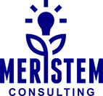
Anne Meysenburg, MPA
Director of Community Investment
Sarah Sjolie, MPA
CEO of Meristem Consulting
Developing a Strategic Plan for Growth
Notes:
Anne and Sarah
Background and experience in leading through mergers

Slide 8
Why explore a partnership, strategic collaboration, or merger?
  More nonprofits, particularly smaller ones, are exploring options for dissolution or merging with other organizations.
  Ninety-seven percent of America’s nonprofits have revenues of less than $5 million, and 92 percent have less than $1 million. Combined, charitable nonprofits employ our nation’s third-largest private workforce.
Council of Nonprofits: https://www.councilofnonprofits.org/articles/rising-interest-nonprofit-dissolutions-mergers
Developing a Strategic Plan for Growth
Notes:
Anne

Slide 9

Why explore a partnership, strategic collaboration, or merger?
Limited non-profit funding availability
  Funders and government
Aligning with symbiotic partners
Economies of scale
Alignment with adjacent organizations
Creating innovation in the marketplace
Developing a Strategic Plan for Growth
Notes:
Anne

Slide 10
Current Funder Mindset
This moment feels similar to the Great Recession
Not-for-profit funding limitations
Inflection point of resource movement
Organizations will have to adapt and prioritize funder asks
Look at what's on fire and what needs attention
What are the priority initiatives for your organization?
Political scrutany
Developing a Strategic Plan for Growth
Notes:
Anne

Slide 11

Monitor for Early Indicators of Future Strategic Changes
Demographic Shifts
Funding
Policy and Regulations
Competitors and Collaborators
https://thepowerofpossibility.org/starting_points/adapting-change-board-level-thinking/
Developing a Strategic Plan for Growth
Notes:
Anne

Slide 12
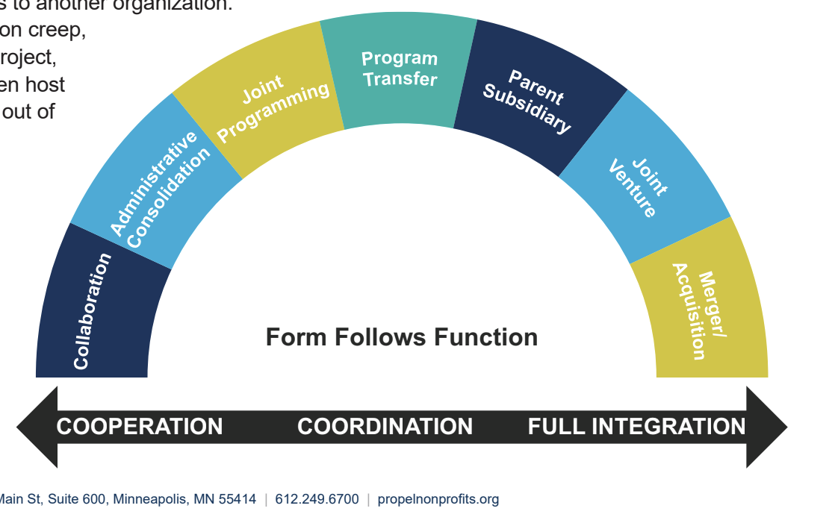
Strategic Alignment Spectrum
Notes:
Anne

Slide 13
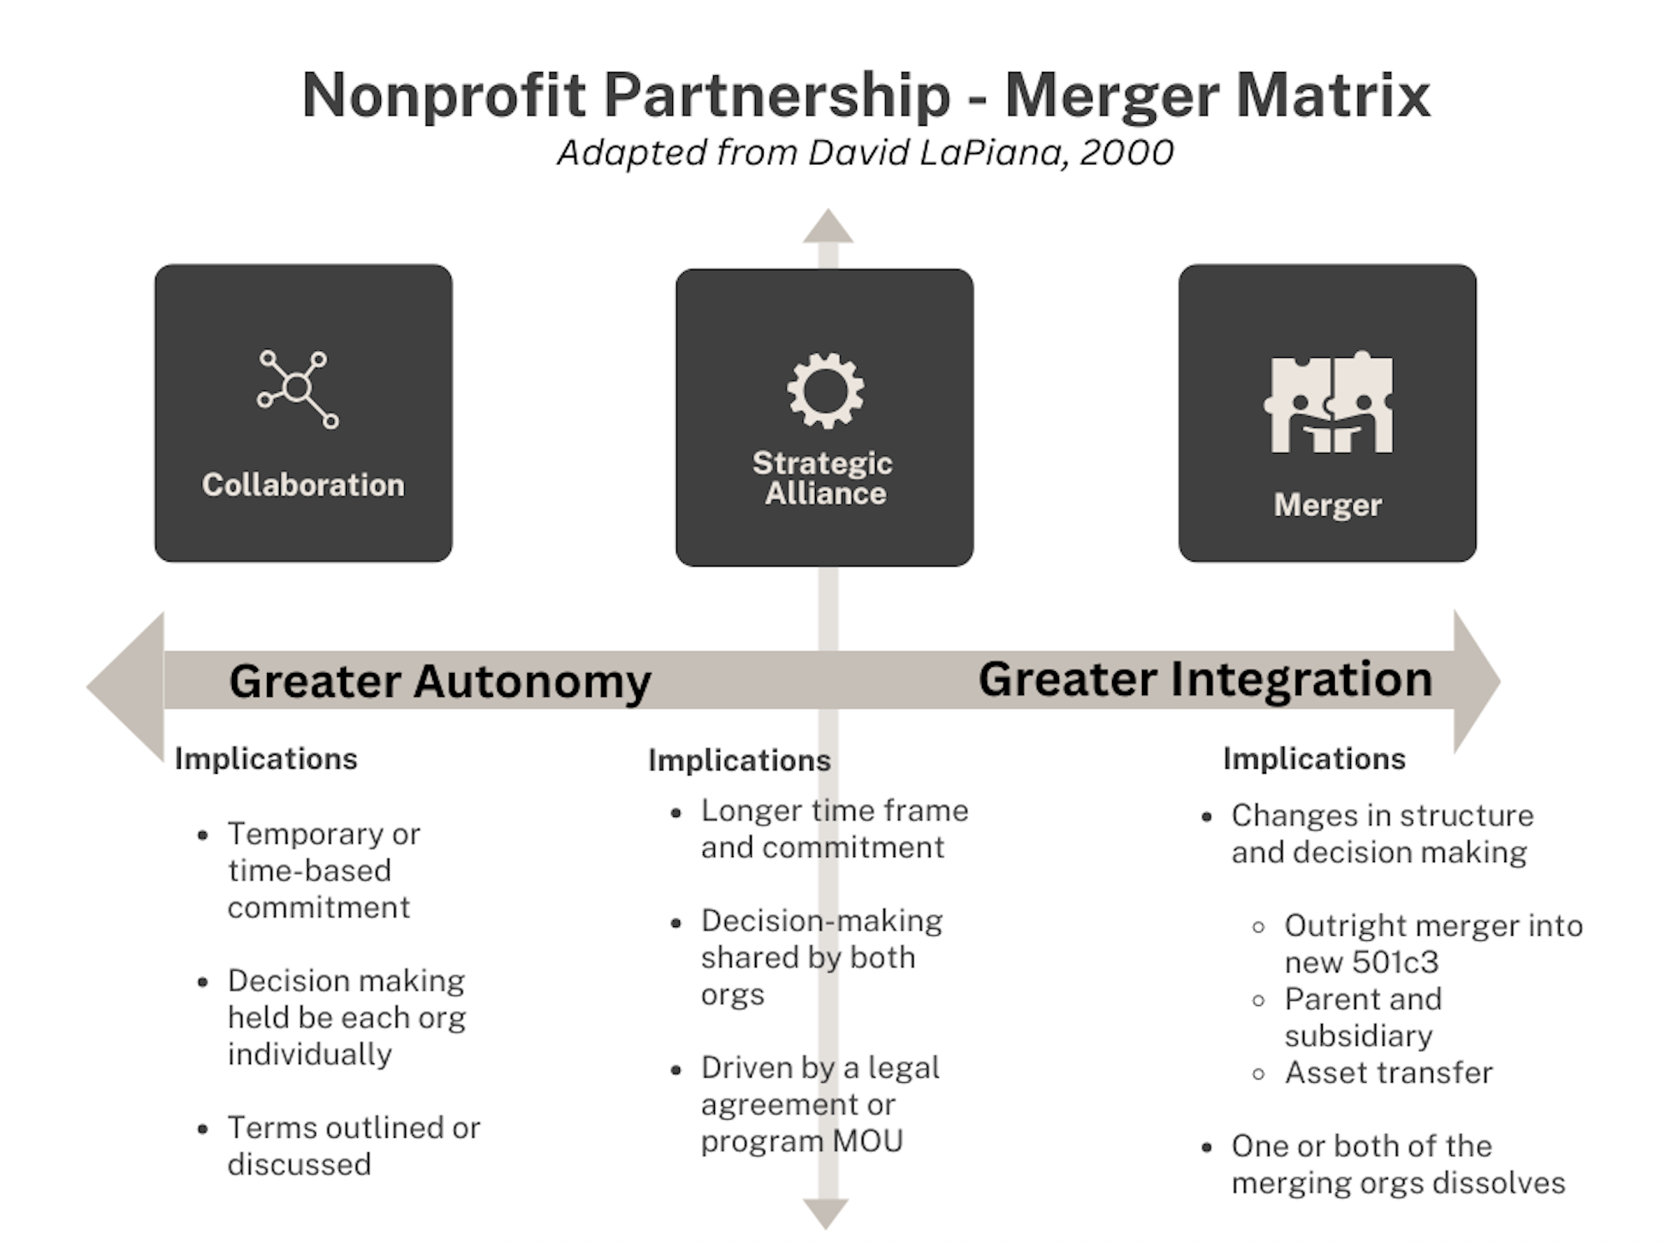
Notes:
Anne

Slide 14
Partnership Matrix
The matrix categorizes partnerships into three main types, moving from less to more integrated:
Collaboration: This involves partnerships with the least amount of organizational commitment. Decisions are made individually by each organization. Examples include; sharing information, coordinating programs, and joint purchasing.
Strategic Alliance: This type of partnership involves a commitment to continue for the "foreseeable future". Decision-making power is either shared or transferred, and the alliance is driven by a formal agreement. Examples include; administrative consolidation, joint programming, and creating a management services organization.
Merger: This is the highest level of partnership, involving significant changes to corporate control or structure. It can lead to the creation or dissolution of one or more organizations. Examples include; a parent-subsidiary structure, a joint venture corporation, or a full merger
Notes:
Anne

Slide 15
Collaboration
Leveraging Strengths and Resources
Notes:
Sarah

Slide 16
Collaboration Considerations
Collaborations can be powerful and highly effective, and they can be a catastrophe without the prior strategy and self-reflection of the entities strengths and values.
Understand your worth as a leader and an organization
Set non-negotiable values prior to engaging and communicate them openly
Don’t let money be the only or key driver, greater impact and mission alignment should be center point
Vet all vendors, partners, and potential collaborators
Discuss the structure of the collaboration early on to avoid any final dealbreakers
Establish ground rules of operations and interactions
Have an exist strategy identified in advance, to utilize if needed
The Soft Underbelly of Nonprofit Collaboration
by Valerie F. Leonard
Notes:
Sarah

Slide 17
Strategic Alignment
Resources and Insights for Not-for-Profits
Notes:
Sarah

Slide 18

What is a Strategic Alliance?
A Strategic Alliance is an approach to align programming and cut costs while staying independent
MOU and outlined financial model outlined in the alliance
Standford Innovation Review: Merging Wisely
Developing a Strategic Plan for Growth
Notes:
Anne

Slide 19
Does a Strategic Alliance or Restructuring Make Sense for Your Organization?
Understand the change and its impact
Look at the change within the context of the core purpose of the organization
Will the change create a financial crunch?
Will a change require a new programmatic strategy or model?
How will this impact staffing or expertise needed?
https://thepowerofpossibility.org/starting_points/adapting-change-board-level-thinking/
Developing a Strategic Plan for Growth
Notes:
Anne

Slide 20
Mergers and Aquisitions
Resources and Insights for Not-for-Profits
Notes:
Sarah

Slide 21
Timeline of Exploration and Merger
Strategic Review
Examine Community Needs
Mission Vs. Money
Letter of Intent
Form Nucleus Committee
Set Goals; Non-negotiables
Due Diligence
Feasibility of Merger/ Practical Steps
Shared Vision/Mission
Notes:
Sarah

Slide 22
Timeline of Exploration and Merger
Agreement
Legal Agreement for Board
Operations Blueprint
Implementation
Communications and Program Plan
Logo Mark, Brand Messages
Membership Approval
Staff-Driven Integration Plan
Notes:
Sarah

Slide 23
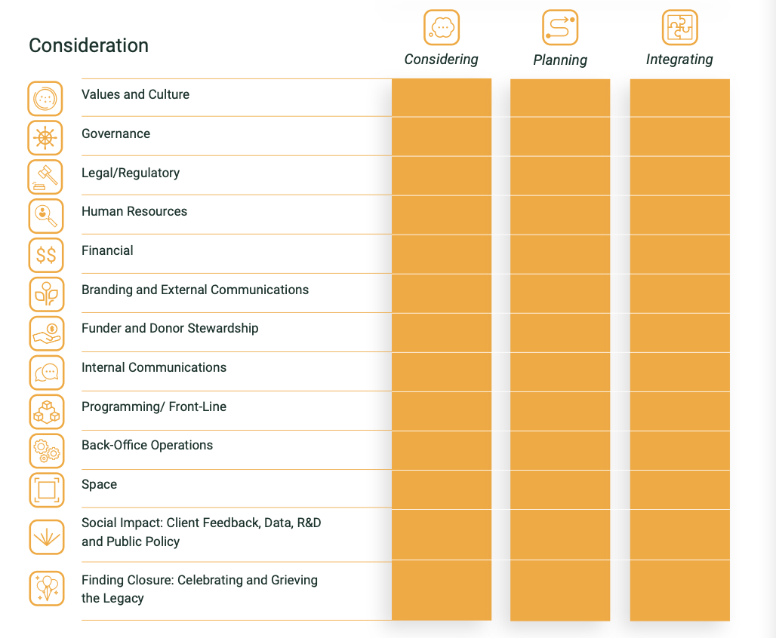
Merger Plan
Considerations
Source: Merging for Good
Notes:
Sarah - If you’re just starting: begin with purpose. Clarify your mission, engage your team, and assess your landscape

Slide 24


Phases of Merger Process:
Live Well Omaha Case Study
Letter of Intent
Fund Development for Shared Merger Cost
Draft Shared Purpose/Mission
Due Diligence
Financial Pro-Forma Comparison
Form Board Nucleous to Guide Process
Stakeholder Interviews
Merger Key Message
Legal Plan of Merger
Launch with New Messaging and Aligned Programs
Notes:
Sarah

Slide 25

Alignment of Mission
Workplace Wellbeing
Community Wellbeing
Population Health
Developing a Strategic Plan for Growth
Notes:
Sarah

Slide 26
Wrap-Up Lessons
Go at the pace of your Board and stakeholders wish to go
Ensure that the movement is rooted in opportunity and the excitement of partnership and not as a rescue boat
Literature lists 1 to 3 months for each step but each organization is different
Seek a Board partner to co-lead the process and lead all merger meetings as the initial sponsor
Notes:
Sarah

Slide 27
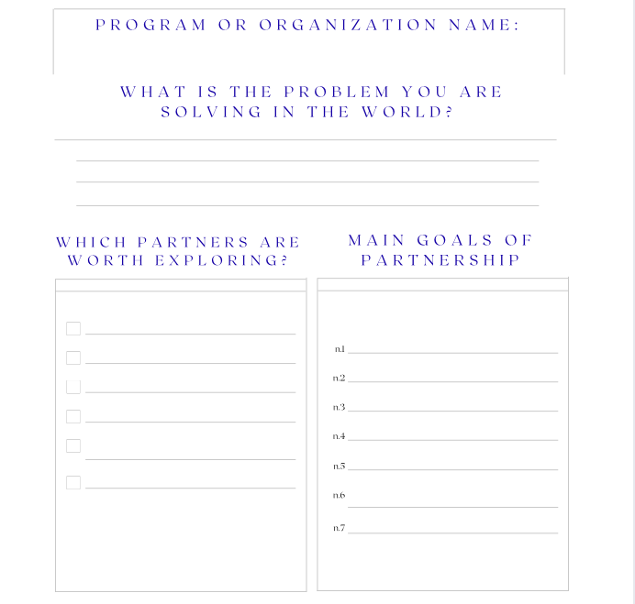
Alignment/Partner
Explorer Tool

Slide 28
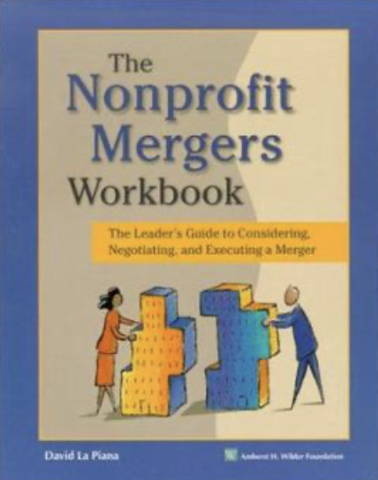
Resources to Access More Information
Nonprofit Mergers Workbook: The Leader's Guide to Considering Negotiating & Executing a Merger
https://www.amazon.com/The-Nonprofit-Mergers-Part-Considering/dp/0940069725
Merge Wisely, Stanford Innovation Review
https://ssir.org/articles/entry/merging_wisely#:~:text=With%20the%20economy%20in%20turmoil,wider%20variety%20of%20partnership%20options.
Mergers & Partnerships
https://www.lapiana.org/services/mergers-alliances/
Notes:
Anne and Sarah

Slide 29
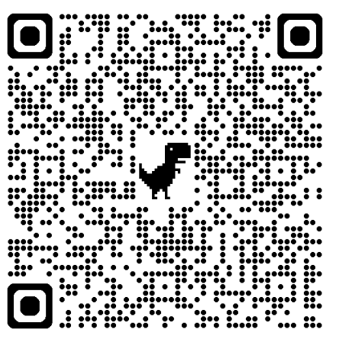
Thank you!
Please Take 5 Minutes to Complete a Brief Evaluation of the Workshop
Please Contact Us with Any Questions:
Dasia@omahafoundation.org
Nathan@omahafoundation.org
Anne@omahafoundation.org
​

